Slide 1
FAIR AND EQUITABLE SHARING OF FINANCIAL AND OTHER ECONOMIC BENEFITS FROM DEEP-SEABED MINING
Supplementary Report Prepared for the Finance Committee of the International Seabed Authority
May 26, 2020

Slide 2
Purpose

Slide 3
Update July 2019 Report
Update previous report from July 2019
  ‘Equitable Sharing of Financial and Other Economic Benefits from Deep-Seabed Mining’ prepared for the Finance Committee of the International Seabed Authority in April 2019.
Examine equitable sharing rules or formulae for shares or proportions of the amount to be distributed in any time period for distributions
Take into account and review suggestions by Finance Committee members.
Focus on Article 140 UNCLOS as first priority
  Any approach for Article 140 distributions can be applied to Article 82 distributions with appropriate adjustments,
  Results will be very similar.

Slide 4
Ex Ante Equity by Developing Two New Allocation Formula
Ex ante (prior to the allocation to each State Party) to achieve a more equitable allocation based upon principle.
Creates total of three allocation formulae:
  Original allocation formula from 2019
  Plus two new allocation formulae that are in themselves fair and equitable.

Slide 5
Ex Post Evaluate Equity & Global Social Welfare from 3 Allocation Formulae
Evaluate ex post (after the allocation to each State Party) the equity and impact upon global social welfare from the allocated share to each State Party from the three alternative allocation formulae.
Use standard measures of relative inequality and impacts upon global social welfare.

Slide 6
Organization
1. Fairness
2. Three Allocation Formulae
3. Empirical Results: All States Parties
4. Empirical Results: States Parties with Per Capita GNIs Less Than Mean Per Capita GNI for All ISA States Parties
5. Alternative Approaches and Formulae Not Adopted
6. Additional Allocations: Indivisible Goods and Priority Principle
7. Conclusions

Slide 7
1. Fairness
Notes:
Discussion taken from extensive literature from economics, philosophy, mathematics, game theory, computer science, political science

Slide 8
What is Fairness?
Fair division is the problem of dividing a good(s) among two or more parties in a way that satisfies a suitable fairness criterion.
Notes:
The equitable and fair allocation must also be self-enforcing in the sense that they yield fair outcomes when the CPCs act in their self-interest and act according to international law and the rules and procedures of the RFMO. The equitable and allocation will also be fair from an a priori standpoint. This class of problem is called a fair division problem

Slide 9
Central Principle of Fair Division
The central tenet of fair division is that such a division should be:
  performed by and according to the valuations of the claimants themselves,
  maybe using a mediator but not an arbiter,
    rather than a third party such as an institution or policy maker,
    since only the claimants really know how they value the goods.
From a procedural point of view, the decision must be unanimous.

Slide 10
Fairness in this Analysis
Many definitions of fairness.
This allocation process is fair because one State one vote and consensus on Resolutions in a voluntary, self-enforcing organization.
Fairness can also be judged on outcomes (consequences)
  Consequentialist moral theory.
Resulting allocation will be fair division since all parties must agree upon allocation.
Notes:
Allocation is fair division when claimants decide directly through a process of direct bargaining rather than through a third party. Young, P. 1994. Equity: How Groups Divide Goods and Burdens Among Their Members, Princeton University Press, Princeton, pp. 116-117.
An envy-free distribution occurs if no party prefers another’s portion of a particular allocation of a good to one’s own (Foley 1967, Varian 1974, Young 1994, Kolm 1996, Moulin 2003, Thomson 2011).
Envy-free distribution only applies when parties have equal claims on the good, which is not strictly true here

Slide 11
2. Three Allocation Formulae

Slide 12
Ex Ante Equity: 3 Allocation Formulae
Predicated upon ex ante notions of equity:
  1. based upon Aristotle’s equity principle and
  2. made progressive in income distribution through weighting by a social distribution weight (arising out of a social welfare function).

Slide 13
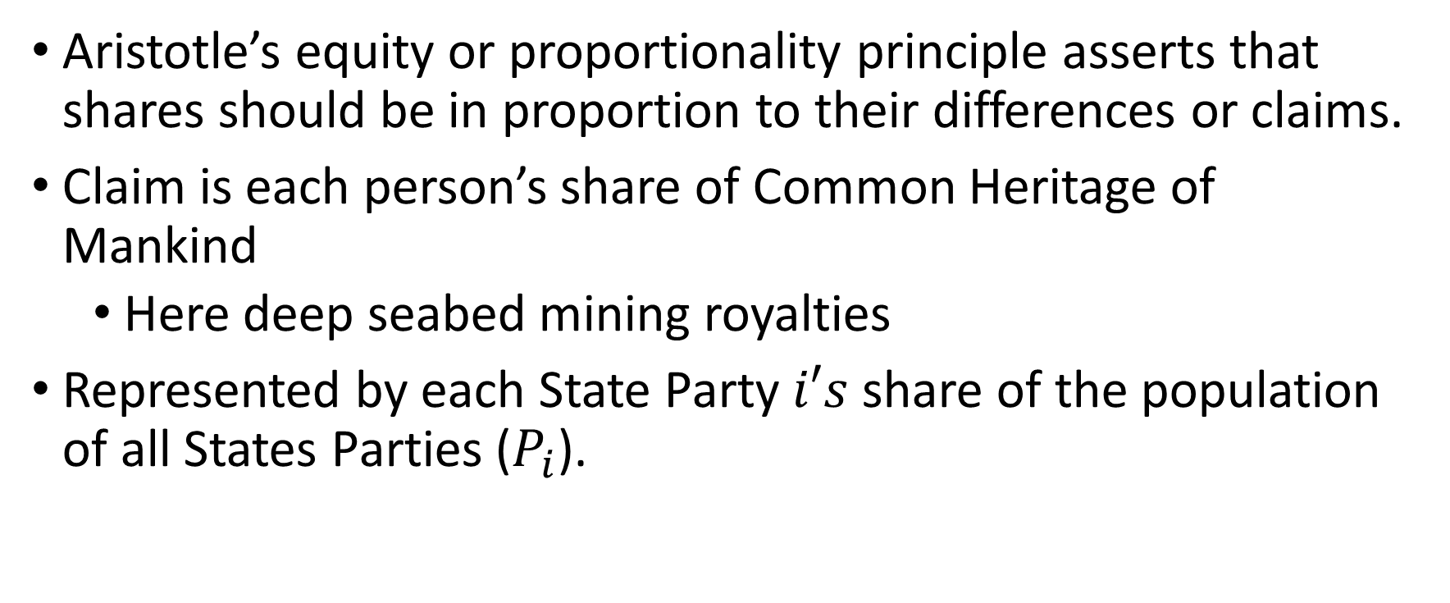
Aristotle’s Equity (Proportionality) Principle
Aristotle’s equity or proportionality principle asserts that shares should be in proportion to their differences or claims.
Claim is each person’s share of Common Heritage of Mankind
  Here deep seabed mining royalties
Represented by each State Party $i′s$ share of the population of all States Parties ($P_{i}$).

Slide 14
Progressivity
Progressivity in income distribution
Share of proceeds received by low-income States Parties for Article 140 proceeds (and low-income, landlocked States Parties in the case of Article 82 proceeds) is higher than the share received by higher-income States Parties and high-income, landlocked coastal States Parties, respectively.
The reference point is given by mean global per capita income.
Implemented through social distribution weight
Ethical valuation of progressivity through revealed preferences of UN General Assembly.

Slide 15
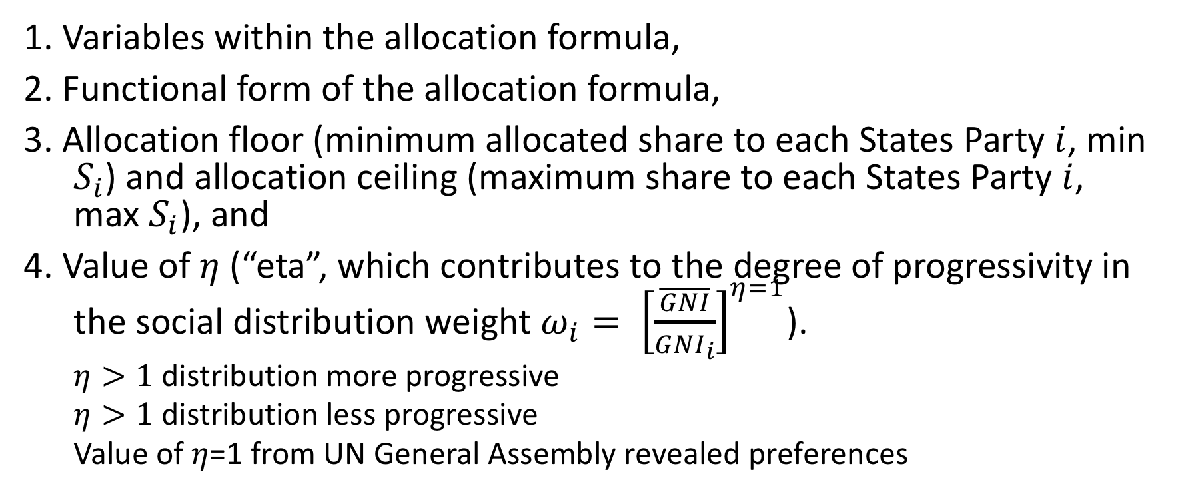
Factors to Vary in Formulae
1. Variables within the allocation formula,
2. Functional form of the allocation formula,
3. Allocation floor (minimum allocated share to each States Party $i$, min $S_{i}$) and allocation ceiling (maximum share to each States Party $i$, max $S_{i}$), and
4. Value of $η$ (“eta”, which contributes to the degree of progressivity in the social distribution weight $ω_{i}= {\left[\frac{\overline{GNI}}{{GNI}_{i}}\right]}^{η=1}$).
  $η>1$ distribution more progressive
  $η>1$ distribution less progressive
  Value of $η$=1 from UN General Assembly revealed preferences

Slide 16

3 Alternative Formulae
1. Original functional form (original formula)
2. Original formula with floor and ceiling
  original formula with minimum and maximum allocated shares $S_{i}$
3. Geometric mean functional form.

Slide 17
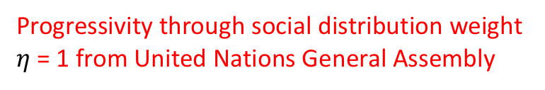
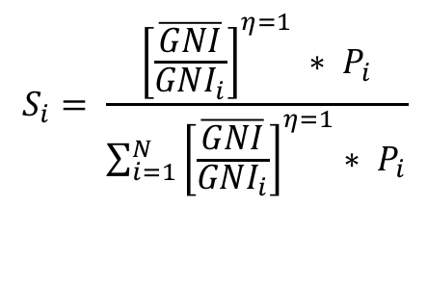
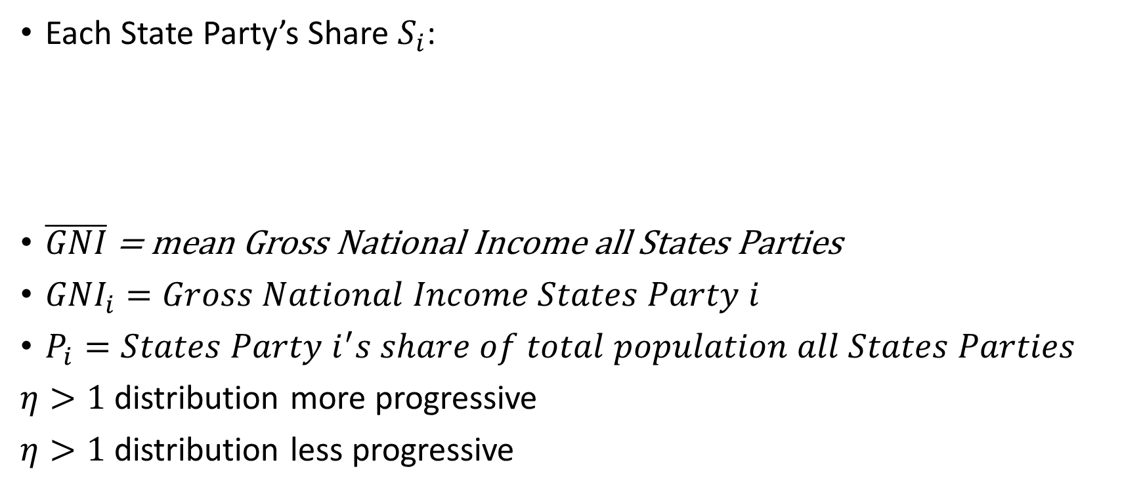
Original Formula for Each States Party’s Share
Progressivity through social distribution weight
$η$ = 1 from United Nations General Assembly
Each State Party’s Share $S_{i}$:
$\overline{GNI}$ = mean Gross National Income all States Parties
${GNI}_{i}=Gross National Income States Party i$
$P_{i}=States Party i^{′}s share of total population all States Parties$
$η>1$ distribution more progressive
$η>1$ distribution less progressive
Aristotle’s Proportionality Principle
$$S_{i}= \frac{{\left[\frac{\overline{GNI}}{{GNI}_{i}}\right]}^{η=1} ∗ P_{i}}{\sum_{i=1}^{N}{{\left[\frac{\overline{GNI}}{{GNI}_{i}}\right]}^{η=1}}∗ P_{i}}$$

Slide 18
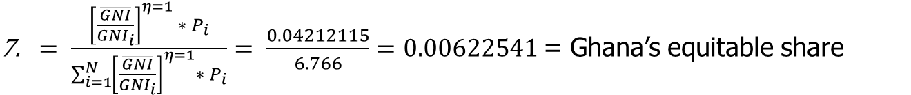
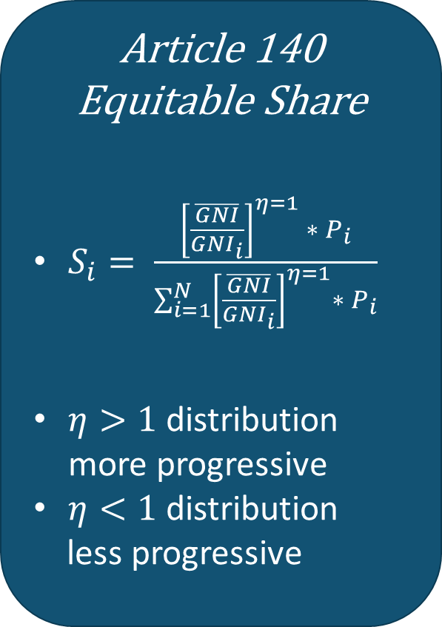
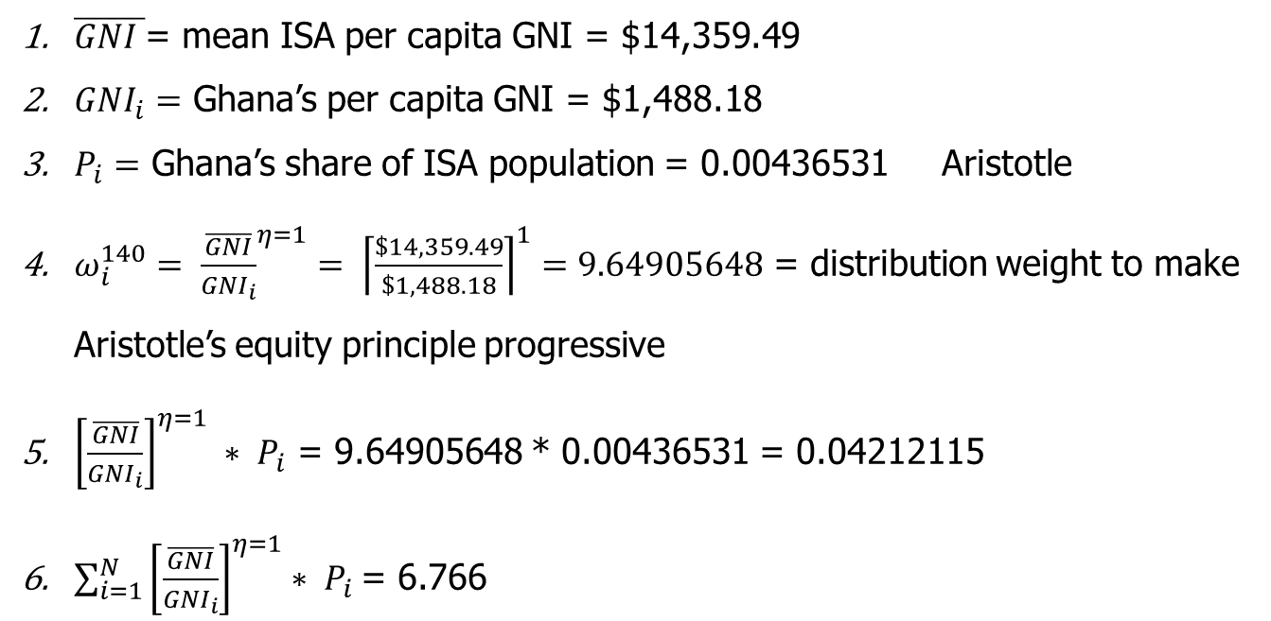
GHANA - ARTICLE 140 EXAMPLE
Article 140 Equitable Share
$S_{i}= \frac{{\left[\frac{\overline{GNI}}{{GNI}_{i}}\right]}^{η=1} ∗ P_{i}}{\sum_{i=1}^{N}{{\left[\frac{\overline{GNI}}{{GNI}_{i}}\right]}^{η=1}}∗ P_{i}}$
$η>1$ distribution more progressive
$η<1$ distribution
less progressive
$\overline{GNI }$= mean ISA per capita GNI = $14,359.49
${GNI}_{i}=$ Ghana’s per capita GNI = $1,488.18
$P_{i}=$ Ghana’s share of ISA population = 0.00436531 Aristotle
$ω_{i}^{140}= {\frac{\overline{GNI}}{{GNI}_{i}}}^{η=1}= {\left\lceil \frac{\$14,359.49}{\$1,488.18}\right\rceil }^{1}=9.64905648$ = distribution weight to make Aristotle’s equity principle progressive
${\left[\frac{\overline{GNI}}{{GNI}_{i}}\right]}^{η=1} ∗ P_{i}$ = 9.64905648 * 0.00436531 = 0.04212115
$\sum_{i=1}^{N}{{\left[\frac{\overline{GNI}}{{GNI}_{i}}\right]}^{η=1}}∗ P_{i}$= 6.766
$= \frac{{\left[\frac{\overline{GNI}}{{GNI}_{i}}\right]}^{η=1} ∗ P_{i}}{\sum_{i=1}^{N}{{\left[\frac{\overline{GNI}}{{GNI}_{i}}\right]}^{η=1}}∗ P_{i}}= \frac{0.04212115}{6.766}=0.00622541$= Ghana’s equitable share
Notes:
MH uses Dale’s slides
How much you want to benefit the developing countries in expense of other countries.
Point out discrepancies in Pacific Small Islands due to their small populations and some have relatively large per capita GNI and some have very small per capita GNI

Slide 19
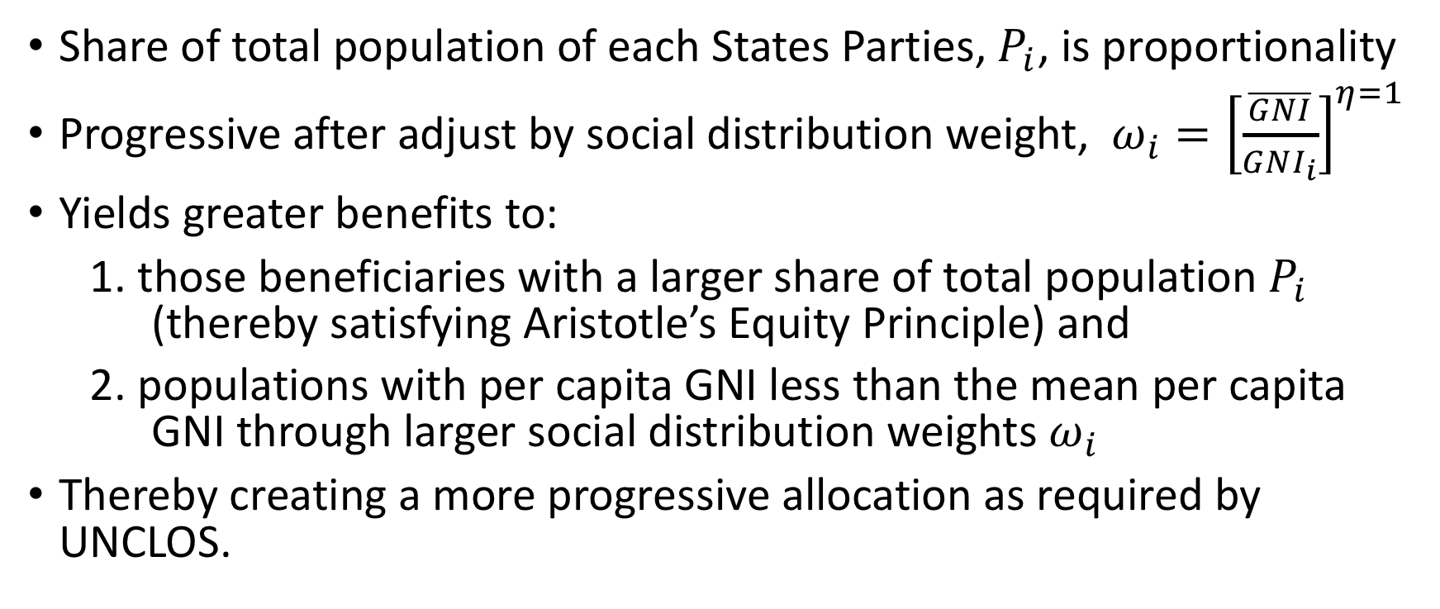

Interpretation of Original Formula for $S_{i}$
Share of total population of each States Parties, $P_{i}$, is proportionality
Progressive after adjust by social distribution weight, $ω_{i}={\left[\frac{\overline{GNI}}{{GNI}_{i}}\right]}^{η=1}$
Yields greater benefits to:
1. those beneficiaries with a larger share of total population $P_{i}$ (thereby satisfying Aristotle’s Equity Principle) and
2. populations with per capita GNI less than the mean per capita GNI through larger social distribution weights $ω_{i}$
Thereby creating a more progressive allocation as required by UNCLOS.

Slide 20
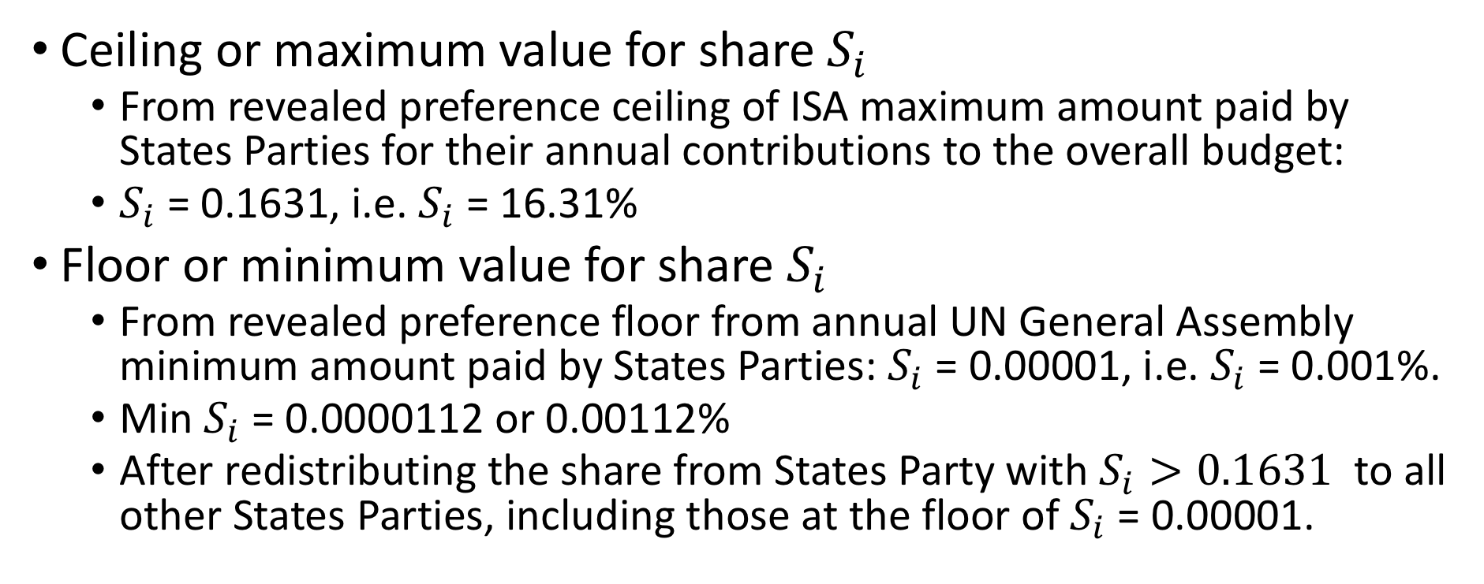
Original Formula with Floor and Ceiling
Ceiling or maximum value for share $S_{i}$
  From revealed preference ceiling of ISA maximum amount paid by States Parties for their annual contributions to the overall budget:
  $S_{i}$ = 0.1631, i.e. $S_{i}$ = 16.31%
Floor or minimum value for share $S_{i}$
  From revealed preference floor from annual UN General Assembly minimum amount paid by States Parties: $S_{i}$ = 0.00001, i.e. $S_{i}$ = 0.001%.
  Min $S_{i}$ = 0.0000112 or 0.00112%
  After redistributing the share from States Party with $S_{i}>0.1631$ to all other States Parties, including those at the floor of $S_{i}$ = 0.00001.

Slide 21
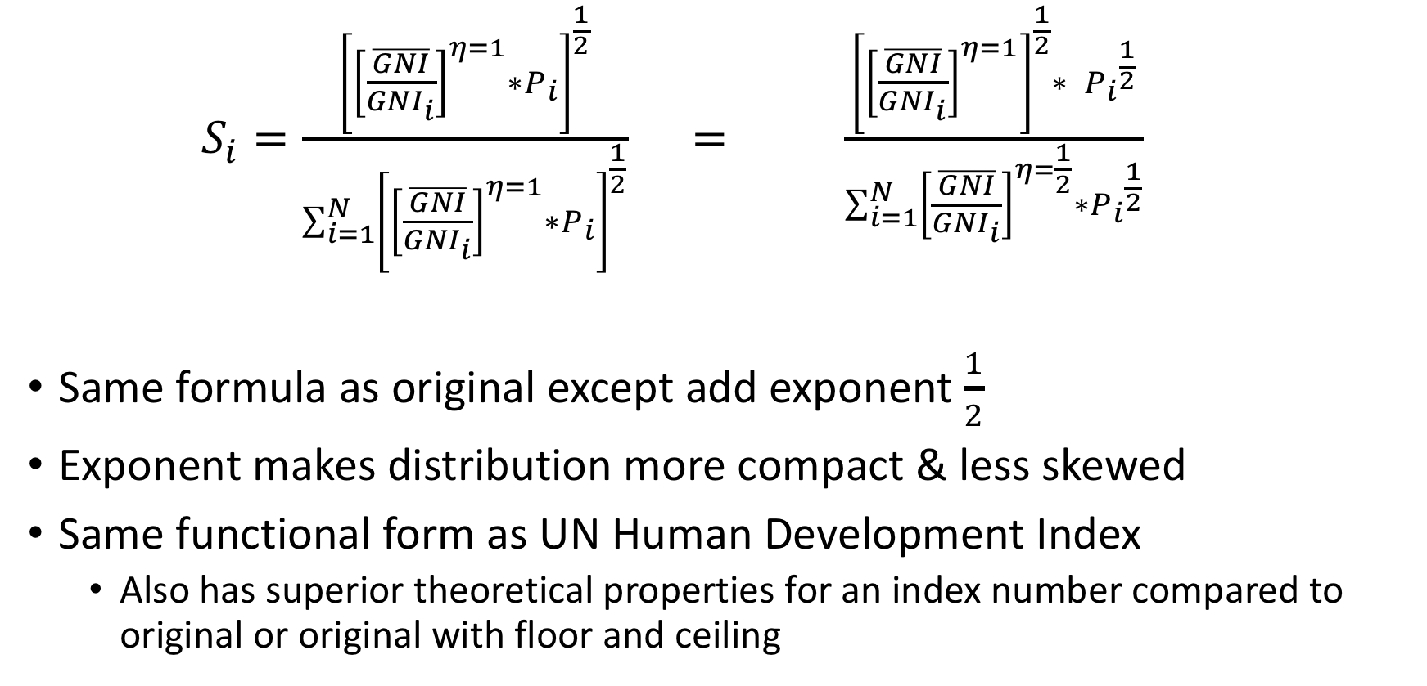
Geometric Mean Formula
Makes distribution more compact
and less skewed
$S_{i}=\frac{{\left[{\left[\frac{\overline{GNI}}{{GNI}_{i}}\right]}^{η=1}∗P_{i}\right]}^{\frac{1}{2}}}{\sum_{i=1}^{N}{{\left[{\left[\frac{\overline{GNI}}{{GNI}_{i}}\right]}^{η=1}∗P_{i}\right]}^{\frac{1}{2}}}}$ $= \frac{{\left[{\left[\frac{\overline{GNI}}{{GNI}_{i}}\right]}^{η=1}\right]}^{\frac{1}{2}}∗ {P_{i}}^{\frac{1}{2}}}{\sum_{i=1}^{N}{{\left[\frac{\overline{GNI}}{{GNI}_{i}}\right]}^{η=\frac{1}{2}}}∗{P_{i}}^{\frac{1}{2}}}$
Same formula as original except add exponent $\frac{1}{2}$
Exponent makes distribution more compact & less skewed
Same functional form as UN Human Development Index
  Also has superior theoretical properties for an index number compared to original or original with floor and ceiling

Slide 22
Ex Post Evaluation of Equity of the Allocation Shares from Each Formula
Use standard empirical and formal measures of inequality and global social welfare.
Gini coefficient, Lorenz curves, and Pen’s Parade
  Primarily assess relative inequality per se
  But Gini coefficient and Lorenz curves can be related to social welfare functions under certain conditions
Atkinson Inequality Index,
Generalized Entropy Index.
Both Atkinson and Generalized Entropy Indices measure relative inequality and global social welfare.

Slide 23
3. Empirical Results: All States Parties

Slide 24
Relative Rankings of Equity-Inequality and Global Social Welfare
Ranking from greatest equity and global social welfare to least:
  1. Geometric mean
  2. Original with floor and ceiling
  3. Original
Highest
Lowest

Slide 25
Skewness and Compactness of Allocated Shares
Ranking from least skewed and most compact to most skewed and least compact:
1. Geometric mean: Skewness = 3.92
2. Original formula with floor and ceiling: Skewness = 5.82
3. Original formula: Skewness = 10.11
Lowest
Highest

Slide 26
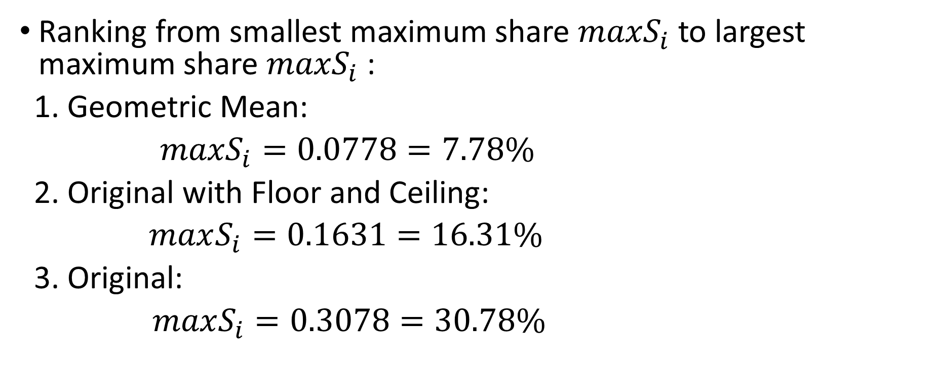

Maximum Shares ${maxS}_{i}$
Ranking from smallest maximum share ${maxS}_{i}$ to largest maximum share ${maxS}_{i}$ :
1. Geometric Mean:
$maxS_{i}=0.0778=7.78\%$
2. Original with Floor and Ceiling:
$maxS_{i}=0.1631=16.31\%$
3. Original:
$maxS_{i}=0.3078=30.78\%$
Lowest
Highest

Slide 27
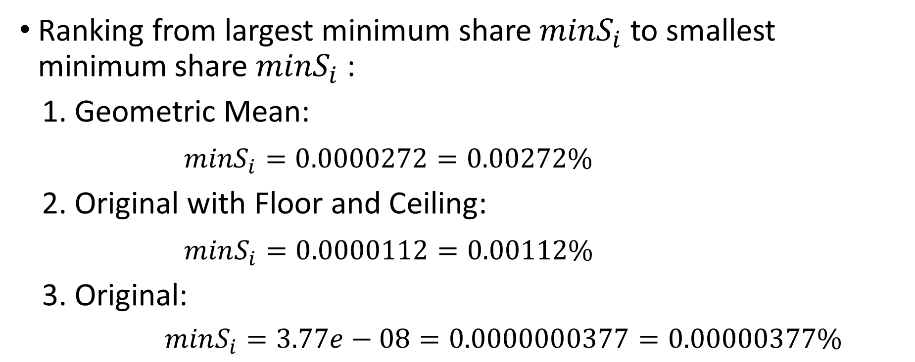

Mimimum Shares ${minS}_{i}$
Ranking from largest minimum share ${minS}_{i}$ to smallest minimum share ${minS}_{i}$ :
1. Geometric Mean:
${minS}_{i}=0.0000272=0.00272\%$
2. Original with Floor and Ceiling:
$minS_{i}=0.0000112=0.00112\%$
3. Original:
$minS_{i}=3.77e−08=0.0000000377=0.00000377\%$
Highest
Lowest

Slide 28
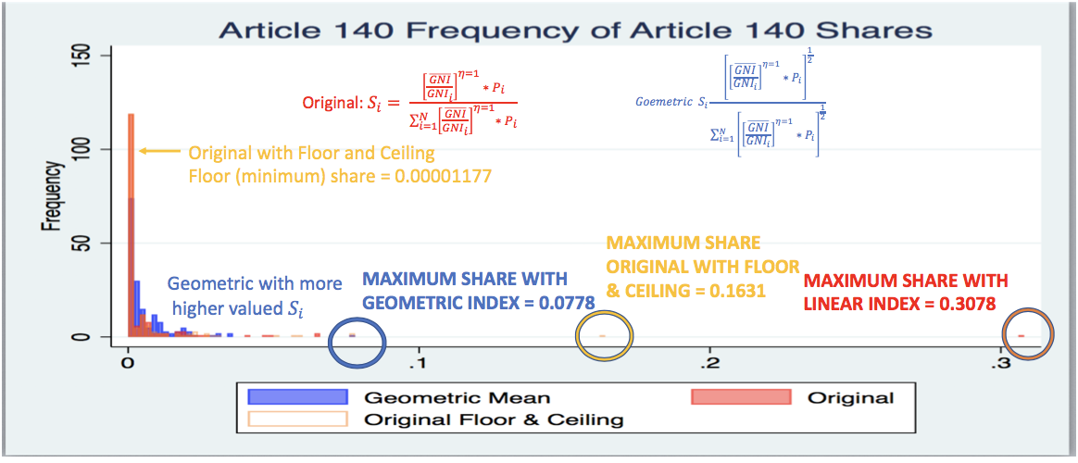
Skewness & Minimum & Maximum Values of Shares $S_{i}$

Slide 29
Skewness & Minimum & Maximum Values of Shares $S_{i}$

Slide 31
Most equity (Geometric)
Least equity
(Original)

Slide 32
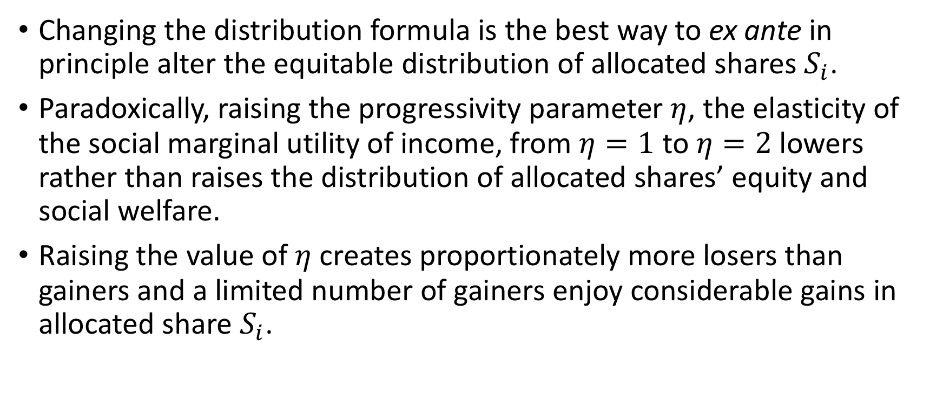

Progressivity Parameter $η$
Changing the distribution formula is the best way to ex ante in principle alter the equitable distribution of allocated shares $S_{i}$.
Paradoxically, raising the progressivity parameter $η$, the elasticity of the social marginal utility of income, from $η=1$ to $η=2$ lowers rather than raises the distribution of allocated shares’ equity and social welfare.
Raising the value of $η$ creates proportionately more losers than gainers and a limited number of gainers enjoy considerable gains in allocated share $S_{i}$.

Slide 33

Which is More Important in Determining Share, Population Share or Social Distribution Weight?
A statistical (generalized linear model regression) analysis shows that share of population $P_{i}$ has several orders of magnitude greater impact upon $S_{i}$ than does the social distribution weight $ω_{i}= {\left[\frac{\overline{GNI}}{{GNI}_{i}}\right]}^{η=1}$ for all three formulae.

Slide 34
4. Empirical Results: States Parties with Per Capita GNIs Less Than Mean Per Capita GNI for All ISA States Parties
Deeper look at States Parties with lower incomes

Slide 35
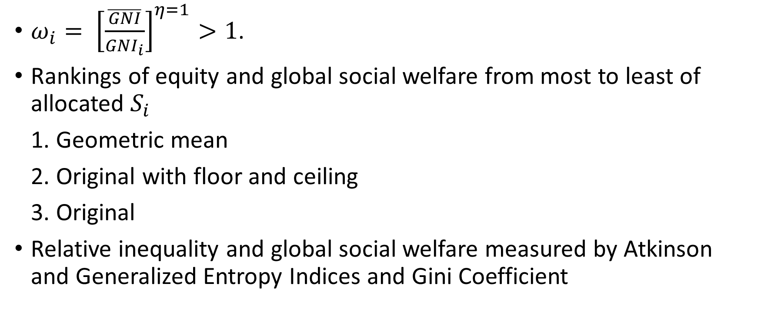
$ω_{i}= {\left[\frac{\overline{GNI}}{{GNI}_{i}}\right]}^{η=1}>1$.
Rankings of equity and global social welfare from most to least of allocated $S_{i}$
1. Geometric mean
2. Original with floor and ceiling
3. Original
Relative inequality and global social welfare measured by Atkinson and Generalized Entropy Indices and Gini Coefficient
Highest
Lowest

Slide 36
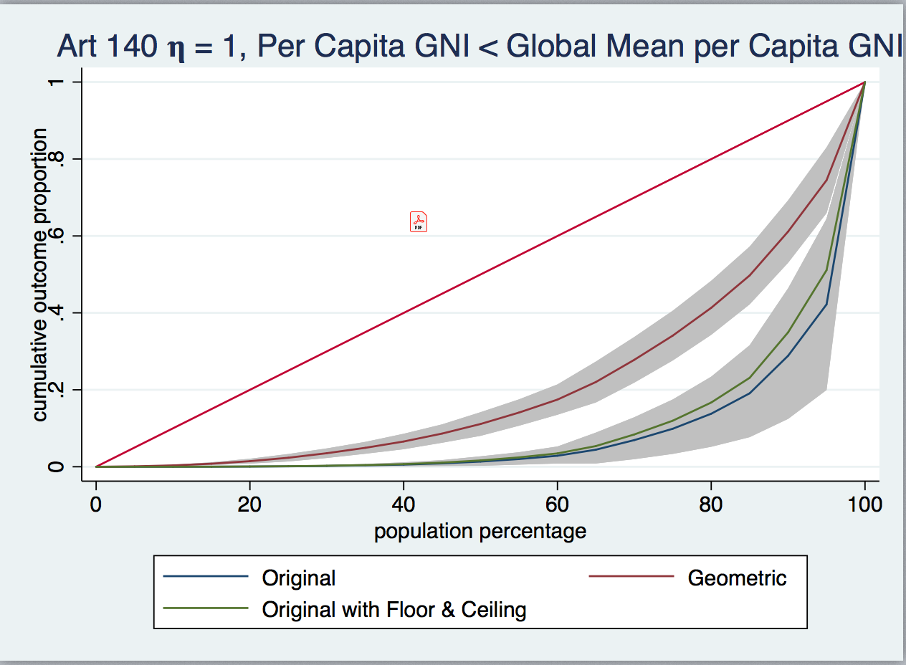
Lorenz Curve
Ranking of equity and global social welfare from most to least equity:
Geometric mean
Original with floor and ceiling
Original
Most equity
(Geometric)
Least equity
(Original)

Slide 37
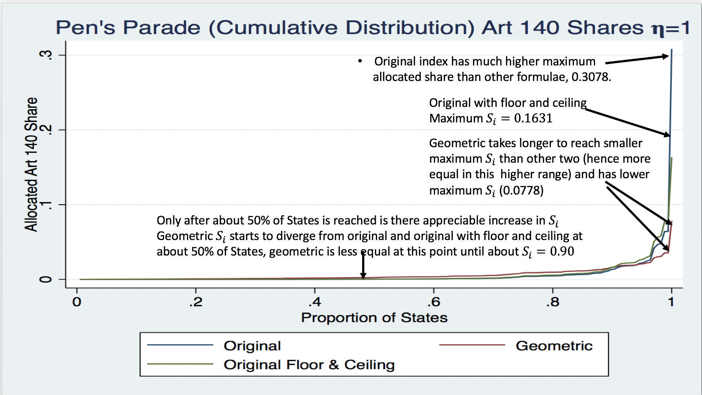

Slide 38
5. Alternative Approaches and Formulae Not Adopted

Slide 39
Other Suggested Options by Finance Committee
Finance Committee suggested several options for the allocation formula (essentially for the numerator).
Each of these has been reviewed.
For the reasons set out below, these approaches would make no meaningful difference to the allocation formula.

Slide 40
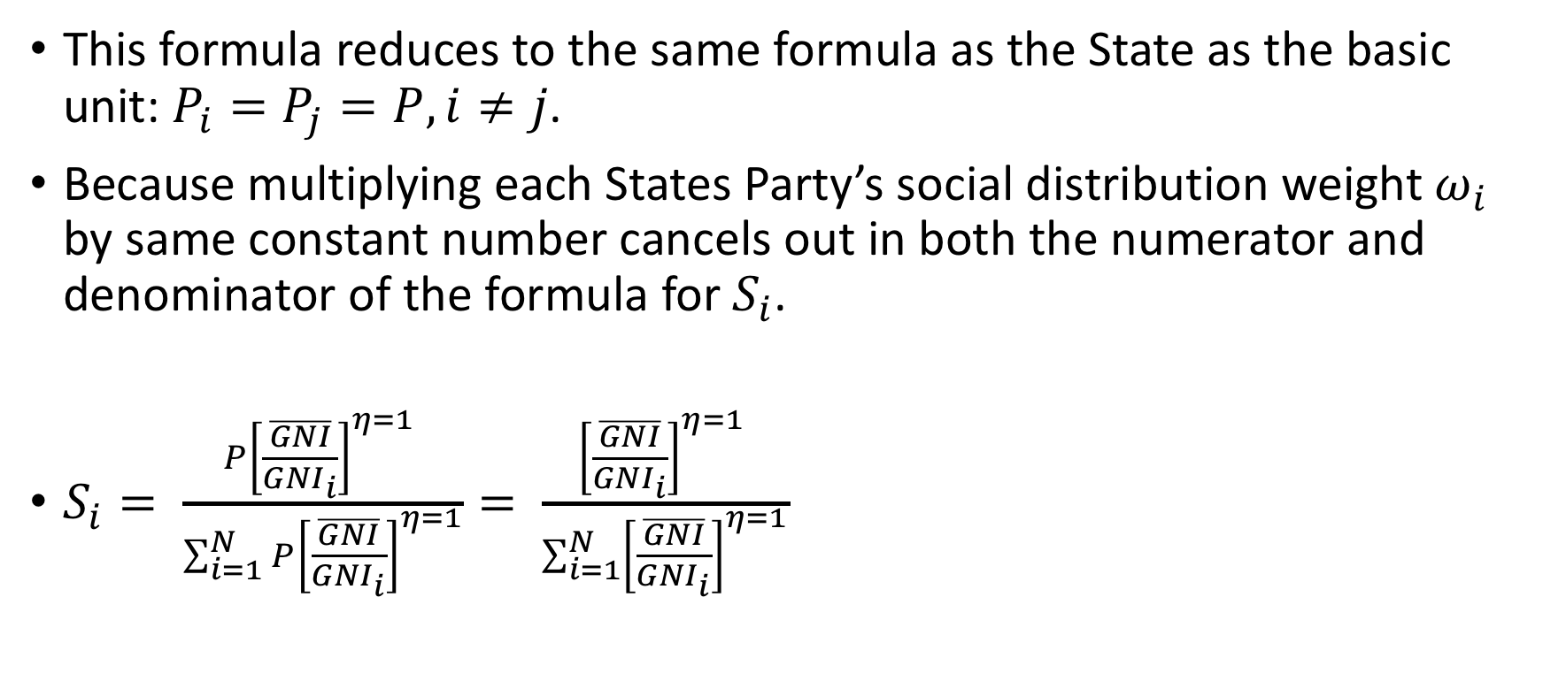
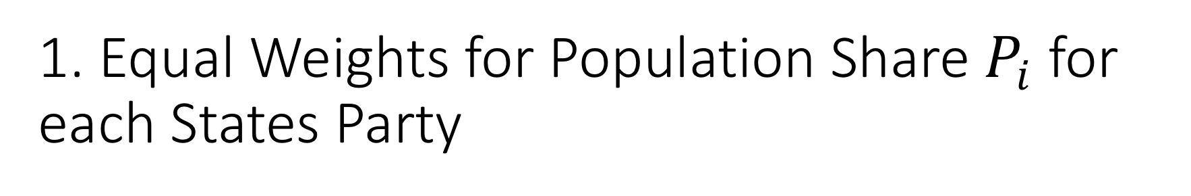
1. Equal Weights for Population Share $P_{i}$ for each States Party
This formula reduces to the same formula as the State as the basic unit: $P_{i}=P_{j}=P, i≠j$.
Because multiplying each States Party’s social distribution weight $ω_{i}$ by same constant number cancels out in both the numerator and denominator of the formula for $S_{i}$.
$S_{i}= \frac{P{\left[\frac{\overline{GNI}}{{GNI}_{i}}\right]}^{η=1} }{\sum_{i=1}^{N}{{P\left[\frac{\overline{GNI}}{{GNI}_{i}}\right]}^{η=1}}}= \frac{{\left[\frac{\overline{GNI}}{{GNI}_{i}}\right]}^{η=1} }{\sum_{i=1}^{N}{{\left[\frac{\overline{GNI}}{{GNI}_{i}}\right]}^{η=1}}}$

Slide 41
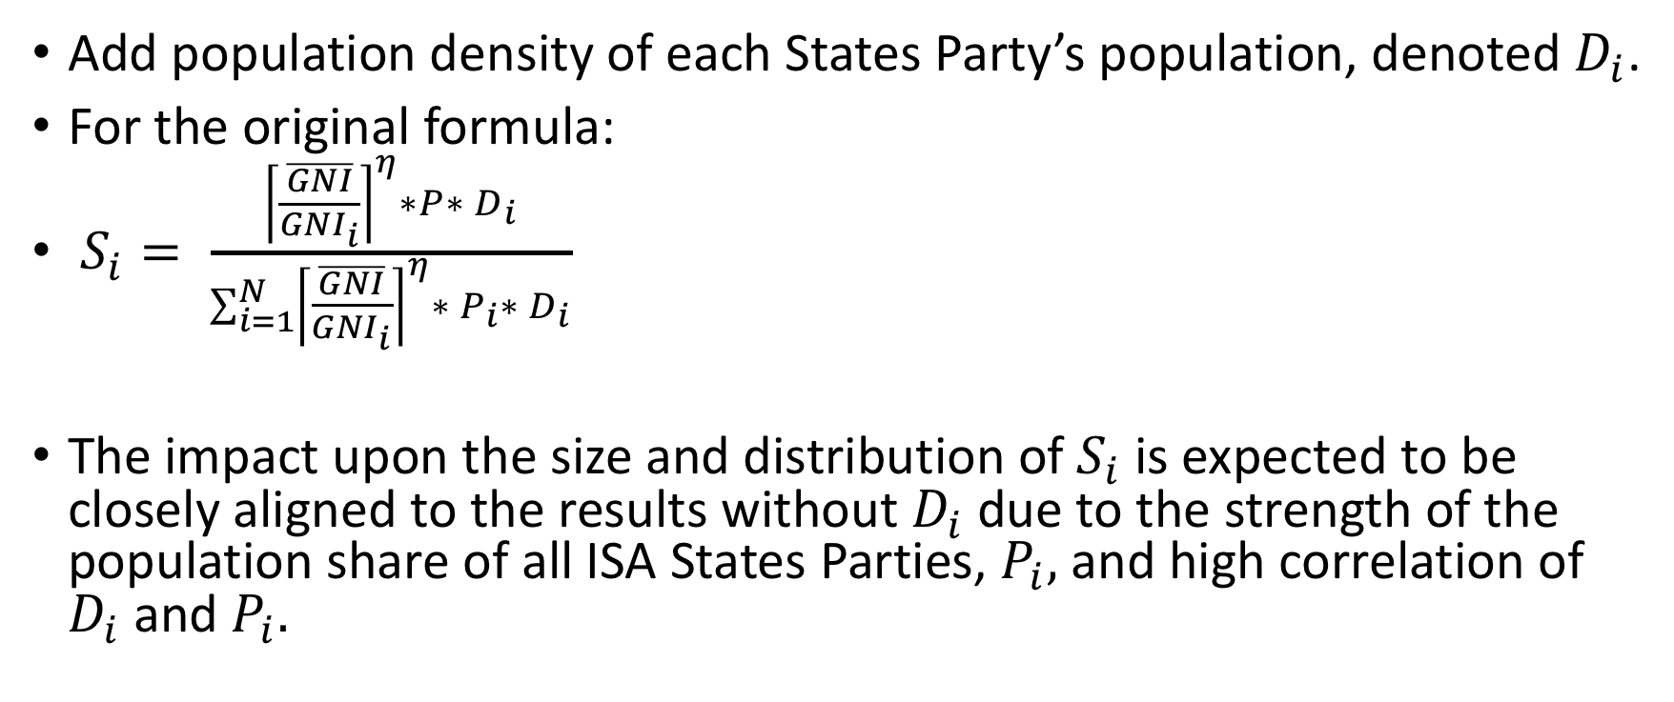
2. Population Density for each State Party
Add population density of each States Party’s population, denoted $D_{i}$.
For the original formula:
$S_{i}= \frac{{\left\lceil \frac{\overline{GNI}}{{GNI}_{i}}\right\rceil }^{η}∗P∗ D_{i}}{\sum_{i=1}^{N}{{\left\lceil \frac{\overline{GNI}}{{GNI}_{i}}\right\rceil }^{η}∗{ P}_{i}∗ D_{i}}}$
The impact upon the size and distribution of $S_{i}$ is expected to be closely aligned to the results without $D_{i}$ due to the strength of the population share of all ISA States Parties, $P_{i},$ and high correlation of $D_{i}$ and $P_{i}.$

Slide 42
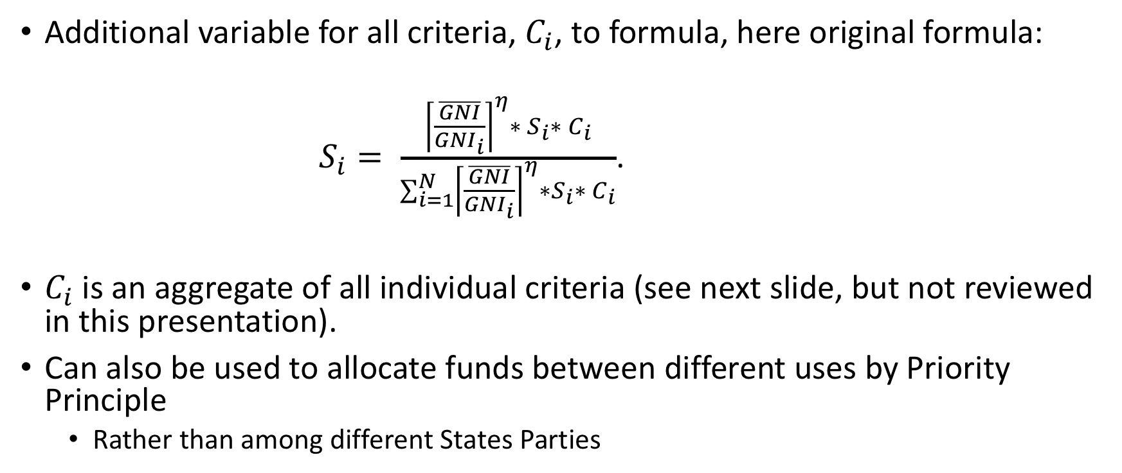
3. Additional Criteria…(1)
Additional variable for all criteria, $C_{i}$, to formula, here original formula:
$S_{i}= \frac{{\left\lceil \frac{\overline{GNI}}{{GNI}_{i}}\right\rceil }^{η}∗ S_{i}∗{ C}_{i}}{\sum_{i=1}^{N}{{\left\lceil \frac{\overline{GNI}}{{GNI}_{i}}\right\rceil }^{η}∗S_{i}∗{ C}_{i}}}$.
$C_{i}$ is an aggregate of all individual criteria (see next slide, but not reviewed in this presentation).
Can also be used to allocate funds between different uses by Priority Principle
  Rather than among different States Parties

Slide 43
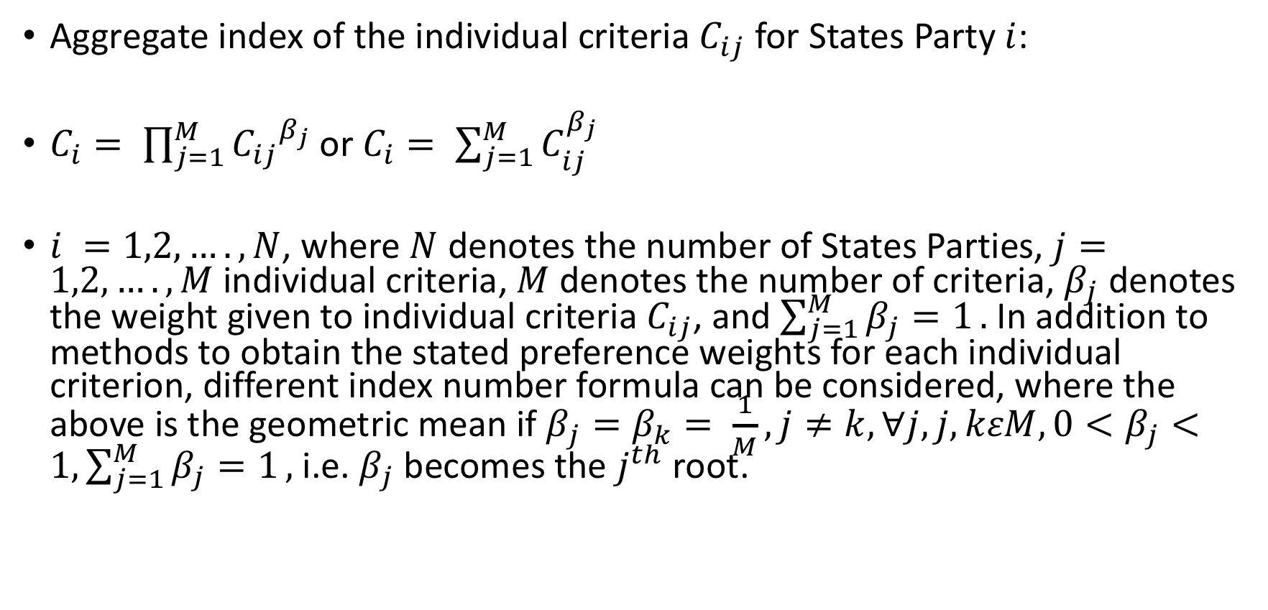
3. Additional Criteria…(2)
Aggregate index of the individual criteria $C_{ij}$ for States Party $i$:
$C_{i}= \prod_{j=1}^{M}{{C_{ij}}^{β_{j}}}$or $C_{i}= \sum_{j=1}^{M}{C_{ij}^{β_{j}}}$
$i =1,2,….,N$, where $N$ denotes the number of States Parties, $j=1,2,….,M$ individual criteria, $M$ denotes the number of criteria, $β_{j}$ denotes the weight given to individual criteria $C_{ij}$, and $\sum_{j=1}^{M}{β_{j}=1}.$ In addition to methods to obtain the stated preference weights for each individual criterion, different index number formula can be considered, where the above is the geometric mean if $β_{j}=β_{k}= \frac{1}{M}, j≠k, ∀j,j,kεM, 0<β_{j}<1,\sum_{j=1}^{M}{β_{j}=1},$ i.e. $β_{j}$ becomes the $j^{th}$ root.

Slide 44
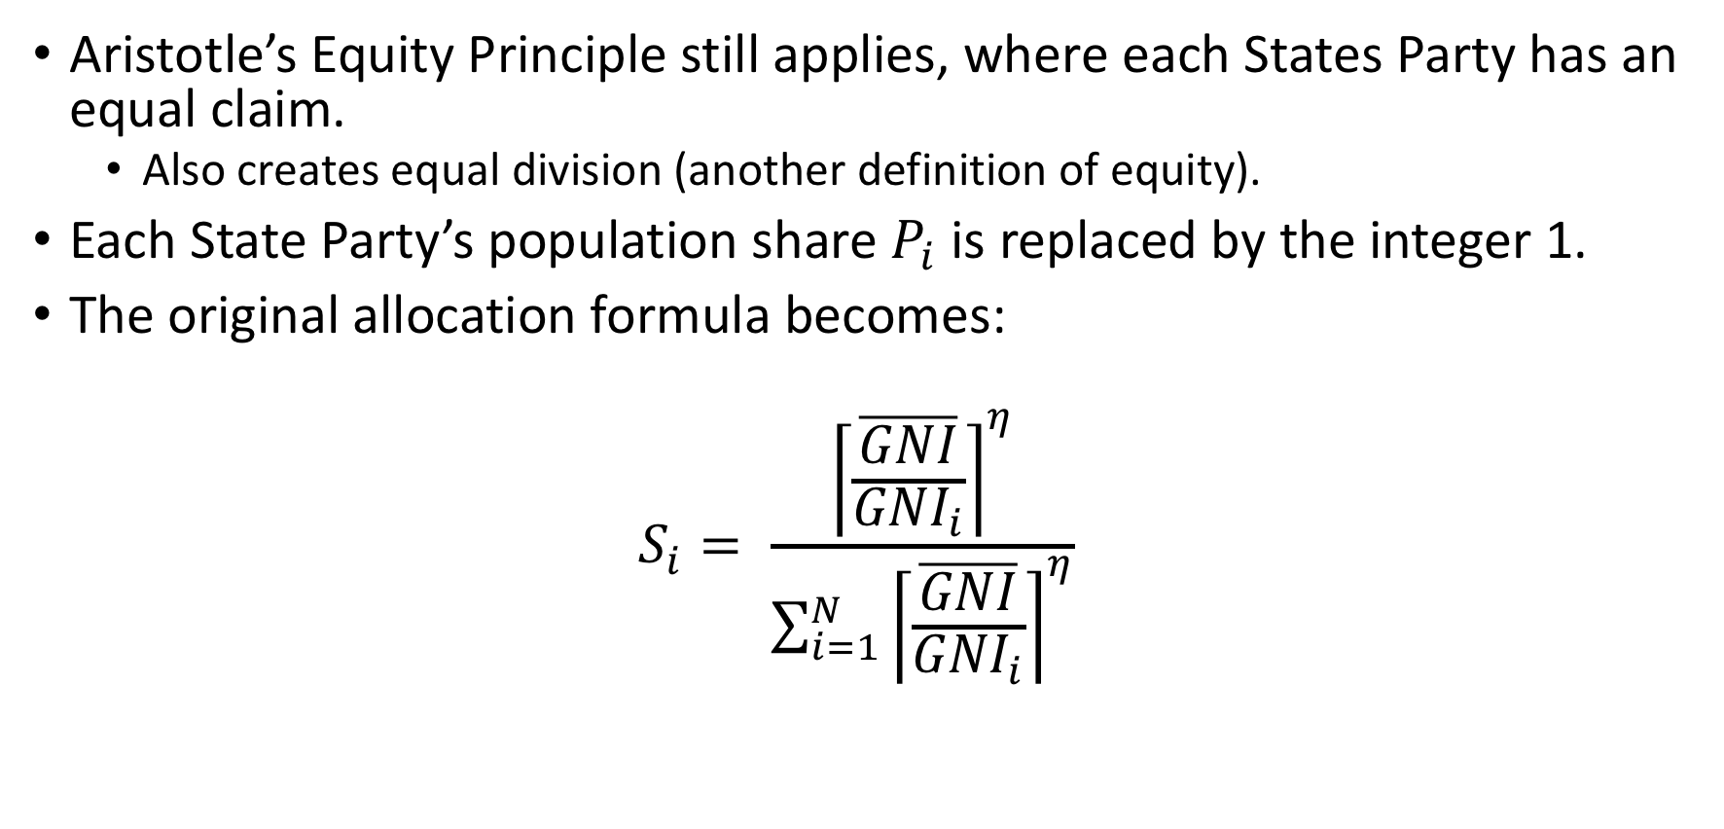
States Party as the Unit rather than the Individual Person…(1)
Aristotle’s Equity Principle still applies, where each States Party has an equal claim.
  Also creates equal division (another definition of equity).
Each State Party’s population share $P_{i}$ is replaced by the integer 1.
The original allocation formula becomes:
$$S_{i}= \frac{{\left\lceil \frac{\overline{GNI}}{{GNI}_{i}}\right\rceil }^{η}}{\sum_{i=1}^{N}{{\left\lceil \frac{\overline{GNI}}{{GNI}_{i}}\right\rceil }^{η}}}$$

Slide 45
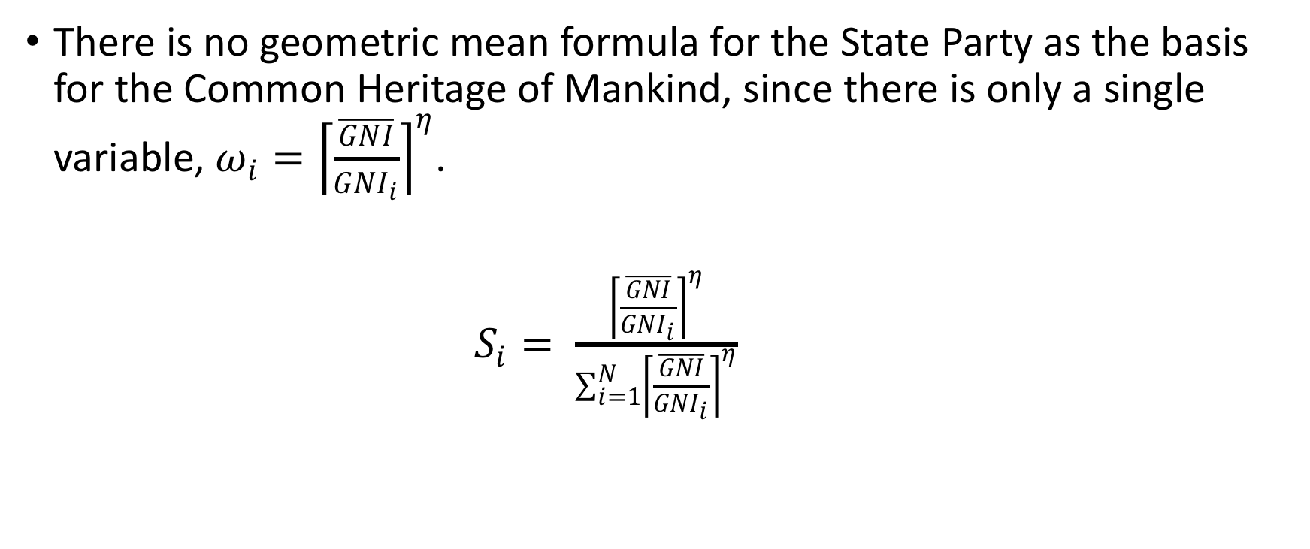
State Party the Unit rather than the Individual Person…(2)
There is no geometric mean formula for the State Party as the basis for the Common Heritage of Mankind, since there is only a single variable, $ω_{i}={\left\lceil \frac{\overline{GNI}}{{GNI}_{i}}\right\rceil }^{η}$.
$S_{i}= \frac{{\left\lceil \frac{\overline{GNI}}{{GNI}_{i}}\right\rceil }^{η}}{\sum_{i=1}^{N}{{\left\lceil \frac{\overline{GNI}}{{GNI}_{i}}\right\rceil }^{η}}}$

Slide 46
6. Additional Allocations: Indivisible
Goods and the Priority Principle

Slide 47
Additional Allocation Issues
Principles of fairness and equity can be applied to other ISA distribution questions.
  Example: Alternative uses of DSM royalties besides direct distribution to States Parties.
  Allocating funds among competing uses is equitably dividing among indivisible, multiple, and heterogenous claims or uses.

Slide 48
Create Fair and Equitable Process and Outcomes…(1)
Create fair and equitable process and outcomes that are transparent, systematic, and focal point for an organized discussion.
Equity and fairness then coordinate the expectations of States Parties to establish a plausible basis for agreement.
Equity principles are the instruments that States Parties use to resolve the distributive bargains.

Slide 49
Create Fair and Equitable Process and Outcomes…(2)
Fairness reduces to a procedural question of how to strike an equitable balance between diverse points of view.
  How to design a process that fairly aggregates individual opinions into a collective decision?
  Equitable ways exist to aggregate individual opinions into a consensus.
  Gives weights to individual criteria to provide an aggregate ranking (see slide 43).

Slide 50
Priority Principle
Priority Principle rather than Aristotle’s Proportionality Principle as basis for equity and fairness.
Priority Principle requires that allocations are made based on a predetermined ranking of claimants (here uses of the funds).
Establish priority among competing uses based upon mixture of criteria.
Weight each individual criteria to give a total score that then ranks alternatives (see slide 43).
Approach widely used to allocate organ transplants (e.g. kidneys)

Slide 51
7. Conclusions

Slide 52
Fair Procedure and Outcome
All allocations are fair in both procedure and outcome.
Due to ISA as a voluntary organization with one State one vote and consensus decision-making.

Slide 53
Three Formulae
Two new formulae evaluated in response to Finance Committee review.
Total of 3 formulae:
  Original
  Original with floor and ceiling
  Geometric mean

Slide 54
Equity through Aristotle’s Equity Principle & Progressivity in Income Distribution
All formulae based upon Aristotle’s equity (proportionality) principle
Made progressive in income distribution by social distribution weight
Ex ante equity through formula with Aristotle’s equity principle & social distribution weight
Ex post equity and global social welfare evaluated by standard measures of relative inequality
  Extends equity analysis to evaluation of global social welfare
  Evaluate allocation formulae through both equity and global social welfare
Rankings of equity and global social welfare always same.
  E.g. highest equity has highest global social welfare

Slide 55
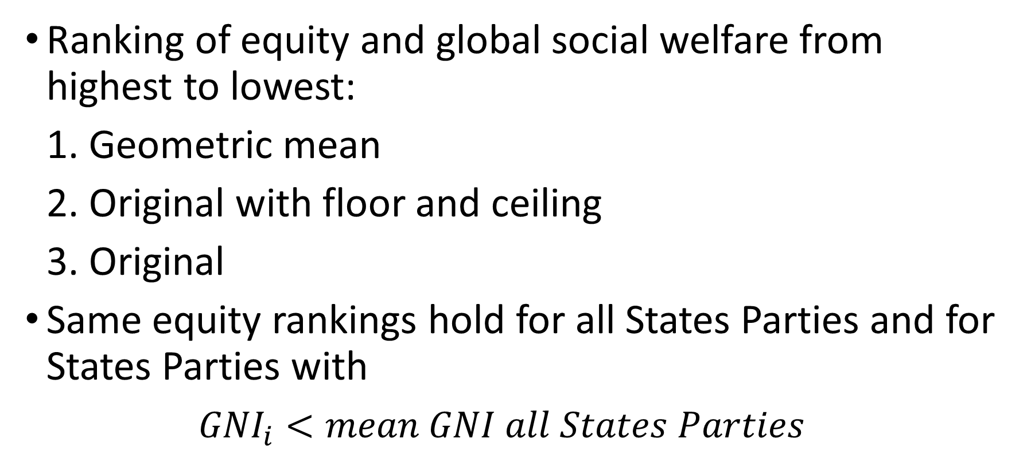
Equity and Global Social Welfare
Ranking of equity and global social welfare from highest to lowest:
1. Geometric mean
2. Original with floor and ceiling
3. Original
Same equity rankings hold for all States Parties and for States Parties with
${GNI}_{i}<mean GNI all States Parties$
Highest
Lowest

Slide 56
Skewness and Compactness
Ranking of skewness and compactness from lowest to highest
1. Geometric
2. Original with floor and ceiling
3. Original
Lowest
Highest

Slide 57
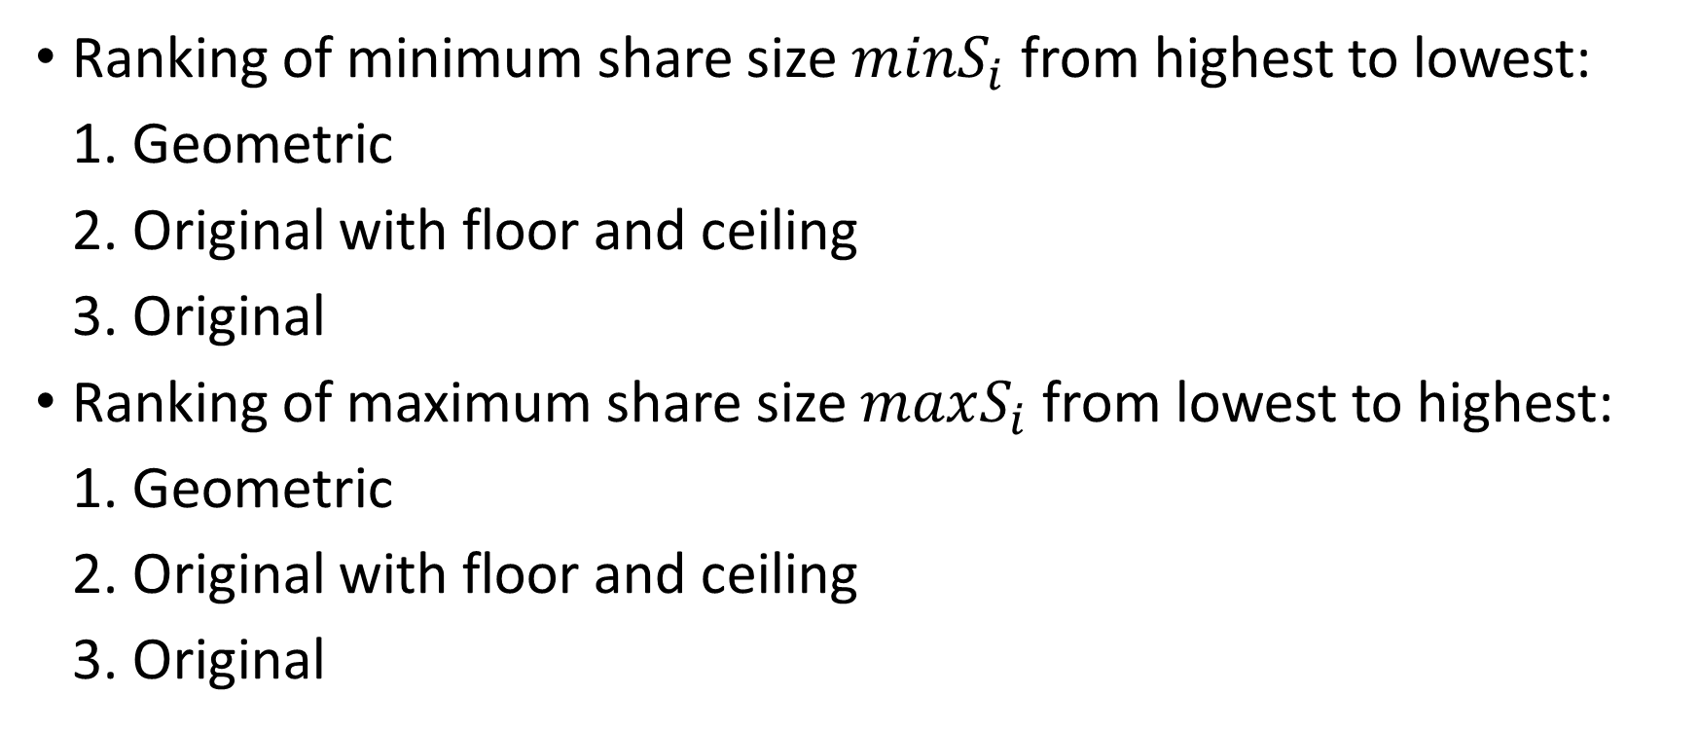
Minimum and Maximum Share Size
Ranking of minimum share size $minS_{i}$ from highest to lowest:
1. Geometric
2. Original with floor and ceiling
3. Original
Ranking of maximum share size $maxS_{i}$ from lowest to highest:
1. Geometric
2. Original with floor and ceiling
3. Original
Highest
Lowest
Lowest
Highest

Slide 58
Penultimate Conclusion for Allocating Royalties Among States Parties
All criteria and methods of evaluating the three alternative allocation formulae for equity and global social welfare yield the same ranking from most preferred to least preferred:
1. Geometric mean
2. Original with floor and ceiling
3. Original
Geometric mean also has the best theoretical properties of an index and has precedent by its use in the UN Human Development Index.
Most Preferred
Least Preferred

Slide 59
Additional Allocation Issues
Fairness reduces to a procedural question of how to strike an equitable balance between diverse points of view.
Priority Principle as equity concept can be used.
  Others are also possible.

Slide 60
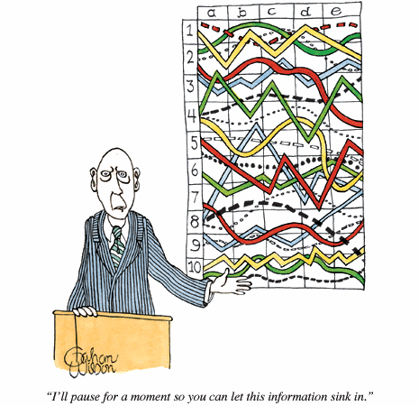
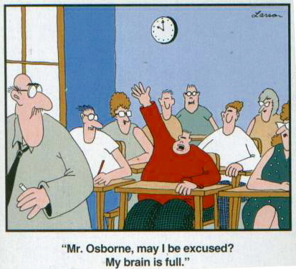
Thanks!..................Questions?

Slide 61
4. Empirical Results: ISA Regions
Supplementary slides – not for presentation

Slide 62
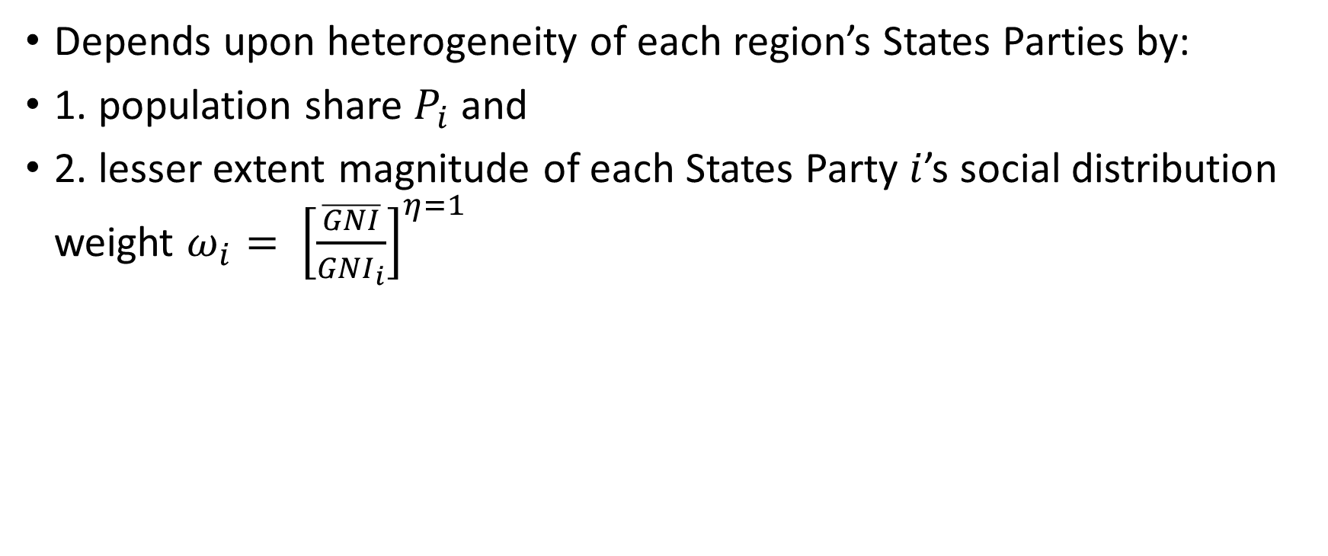
Equity and Social Welfare of Distribution to ISA Regions…(1)
Depends upon heterogeneity of each region’s States Parties by:
1. population share $P_{i}$ and
2. lesser extent magnitude of each States Party $i$’s social distribution weight $ω_{i}= {\left[\frac{\overline{GNI}}{{GNI}_{i}}\right]}^{η=1}$

Slide 63
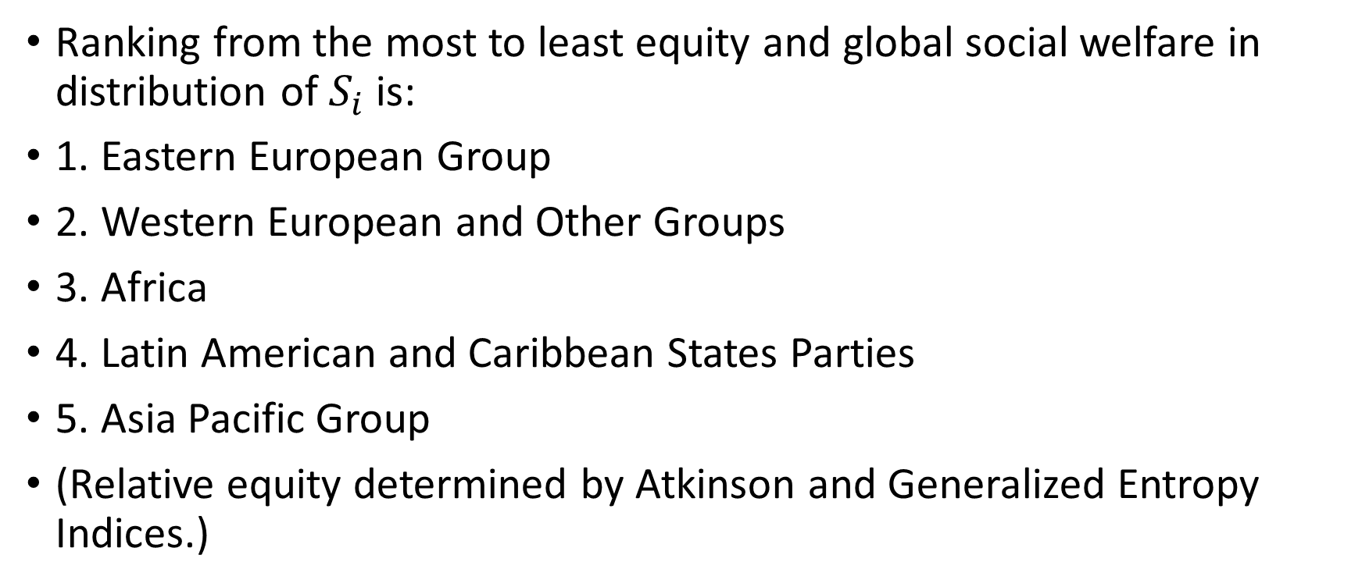
Equity and Social Welfare of Distribution to ISA Regions…(2)
Ranking from the most to least equity and global social welfare in distribution of $S_{i}$ is:
1. Eastern European Group
2. Western European and Other Groups
3. Africa
4. Latin American and Caribbean States Parties
5. Asia Pacific Group
(Relative equity determined by Atkinson and Generalized Entropy Indices.)
Highest
Lowest

Slide 64
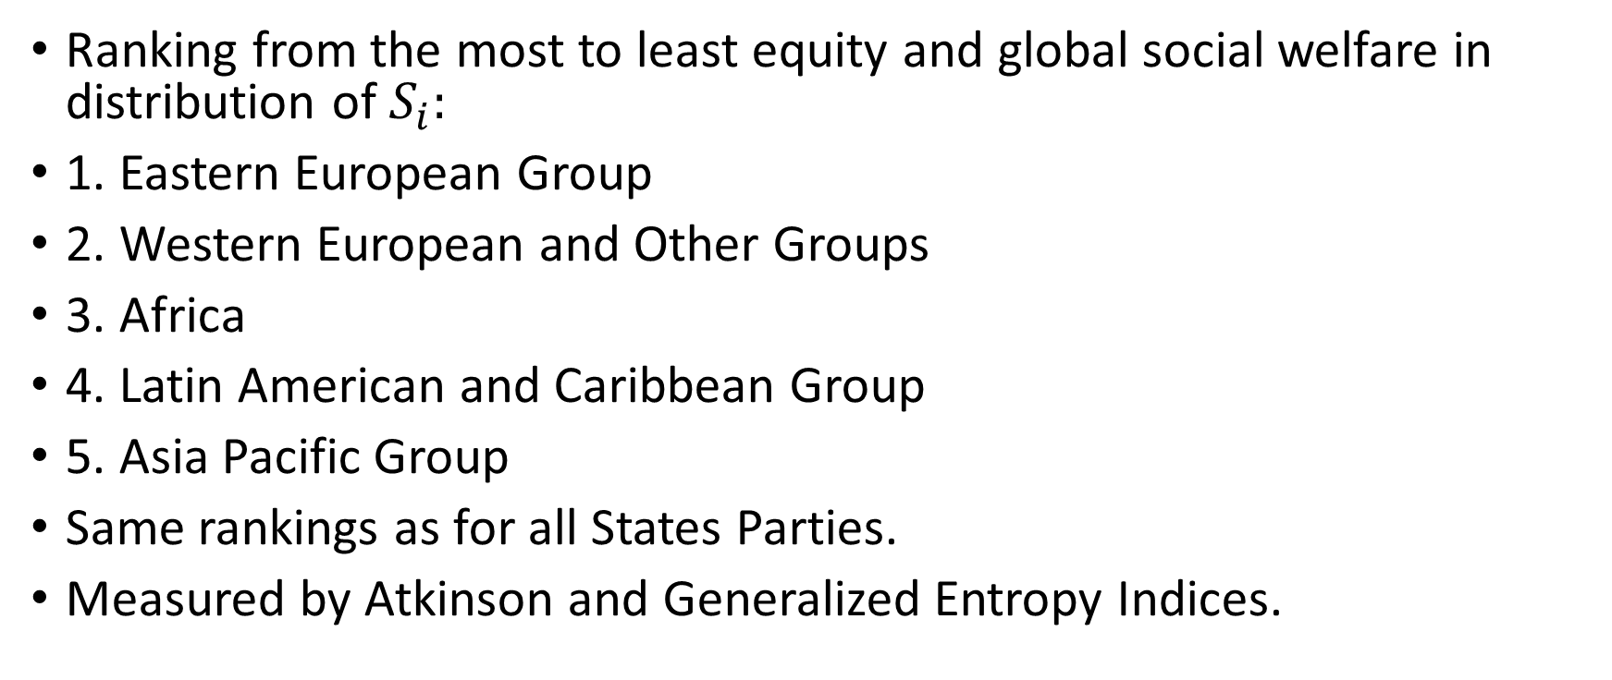
Regional Ranking of Equity and Global Social Welfare
Ranking from the most to least equity and global social welfare in distribution of $S_{i}:$
1. Eastern European Group
2. Western European and Other Groups
3. Africa
4. Latin American and Caribbean Group
5. Asia Pacific Group
Same rankings as for all States Parties.
Measured by Atkinson and Generalized Entropy Indices.
Highest
Lowest

